Slide 1
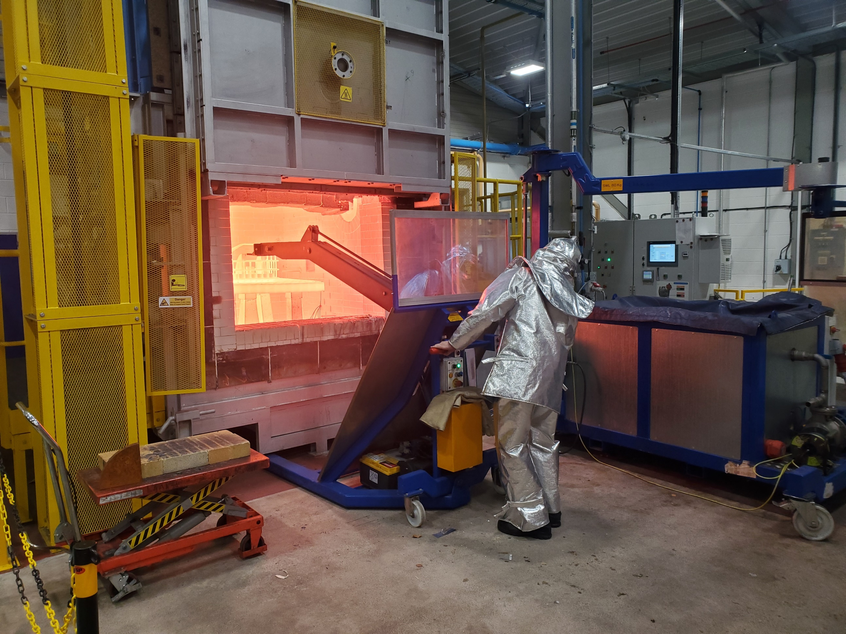


Data Science for Manufacturing: Assignment 2 – Technical Presentation
Data processing, visualisation and analysis associated with the CMI industrial furnace
Aurik Andreu
07/12/2022

Slide 2
Contents
Aims & objectives
Furnace description
Sources of data
Furnace Data
Optional: Ignition platform data
Data cleansing
Data carpentry
Data analysis and visualization
Conclusions and future work
Slide 2

Slide 3
Aims & objectives
The aim of this project is to create a python code(s) to collect, format and visualise process data from the CMI gas fired furnace rather the current method which uses Excel and which is slow, limited and inefficient.
Code efficiency is an area I was particularly interested so for this reason I have added processing time measurement within the notebook to check elapsed time for different stages of the code.
Finally, I wanted to use python functions to carry out some basic analysis such as detecting faulty sensors, filtering, signal integration, etc….
In the future, the intention would be to deploy this methodology/strategy to other industrial furnaces with different data source such as Future Forge furnaces and AFRC member’s furnaces.
Slide 3

Slide 4
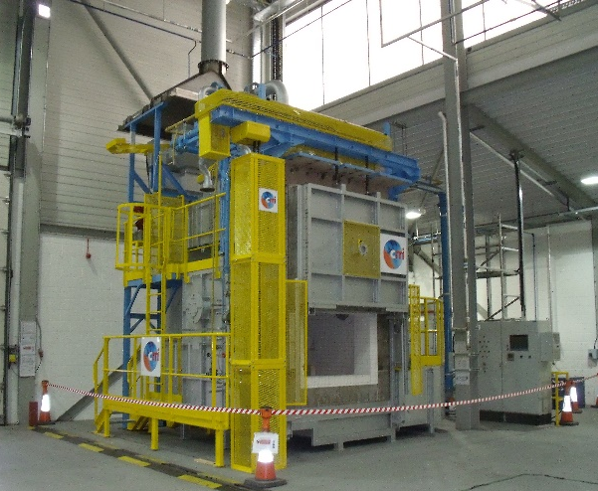
Furnace description
The CMI gas fired furnace is considered as a medium size industrial furnace and can reach a maximum temperature of 1150 ºC.
The useful volume above the grid has the following dimensions: 1000 x 1000 x 700 mm and the grid is supported by 5 firedogs.
The maximum heating rate is 200 °C/h and the expected temperature uniformity is ± 14 °C when the furnace is running in steady state.
The furnace is heated by two natural gas burner BIC80 of 90 kW each.
The furnace is comprised of several elements (combustion air skid, gas skid, furnace BCU zone 1 and 2, door, etc…) that will be described in the next section and numerous process parameters/tags are being recorded within these.
Slide 4

Slide 5
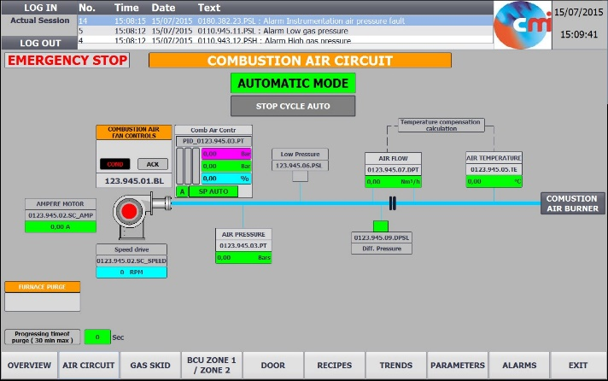
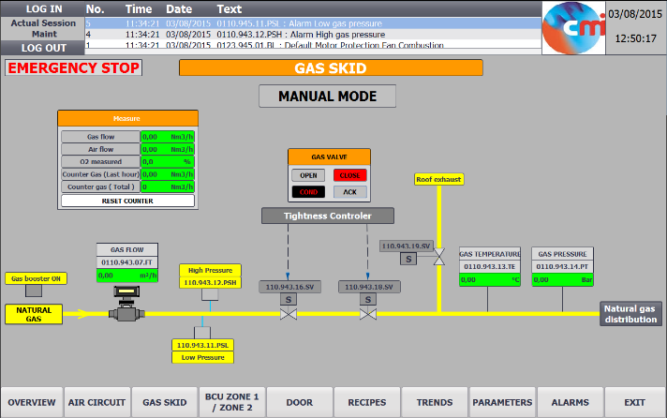
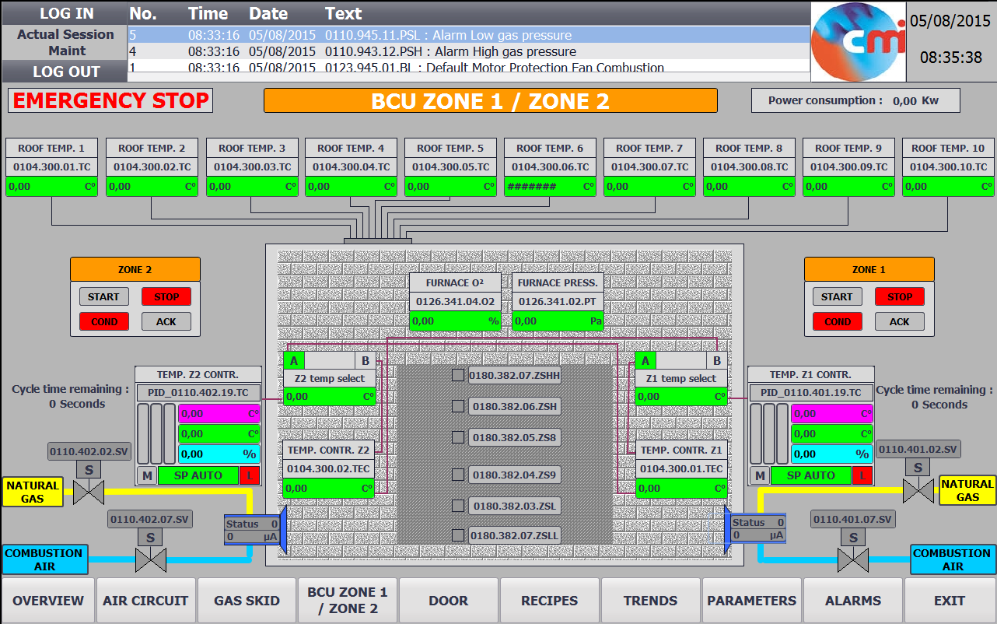
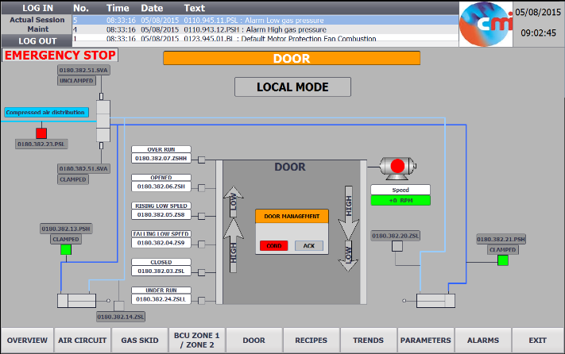
Sources of data
Furnace Data
As mentioned before, 47 individual tags are currently being recorded at a fixed time interval of 2 s (frequency of 0.5 Hz).
All these tags are visible on the various HMI views as represented on the left.
These views aim to draw together all the important information about the furnace to enable the operator to monitor furnace operation in a safely manner.
They are also used to make process change by adjusting some parameters such as temperature, air flow rate, pressure set point, open/close the door etc…
HMI views of the different elements with tags of interest.
Slide 5

Slide 6
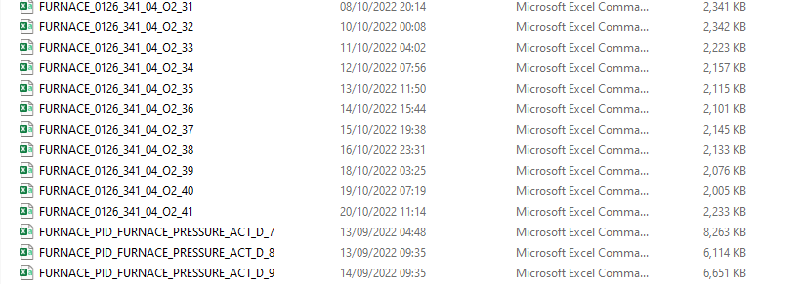
Table – List of furnace tags/process parameters with description and units
The full list of Tags/process parameters and description is displayed in the table on the right.
The process data is recorded on a NAS (network attached storage) and consists of multiple CSV files (one per sensors / per ~day approx.)) (see Figure below).
All the process data are time series i.e. process value vs time stamp which is different from the data we have been using in the course workshops.
Each individual file has a size of couple of MB so the total dataset size of the can go up to several GB depending on the duration of the heat treatment being considered.
Figure – Typical CSV files being recorded on the NAS.
Slide 6

Slide 7
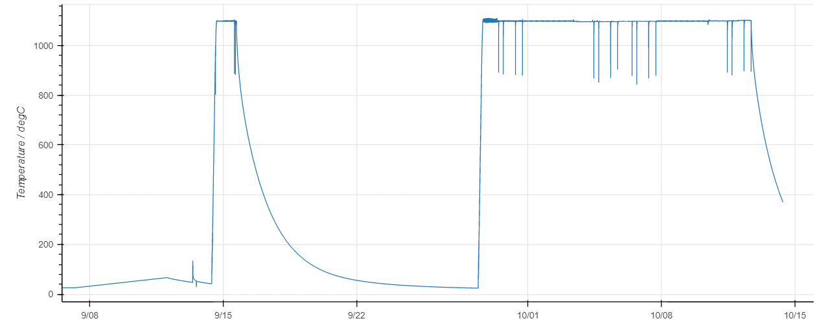
This set of data was recorded from the heating treatment of steel parts at 1100 °C for various oxygen concentration within the furnace (different air to fuel ratio settings on the burners) as well as a test run of the furnace beforehand.
The total duration is more than a month (this was chosen intentionally to represent the worst-case scenario i.e. largest amount of data to check efficiency of python for extremely large dataset).
Figure – Global view of the temperature profile within the furnace for the whole heat treatment duration
Slide 7

Slide 8
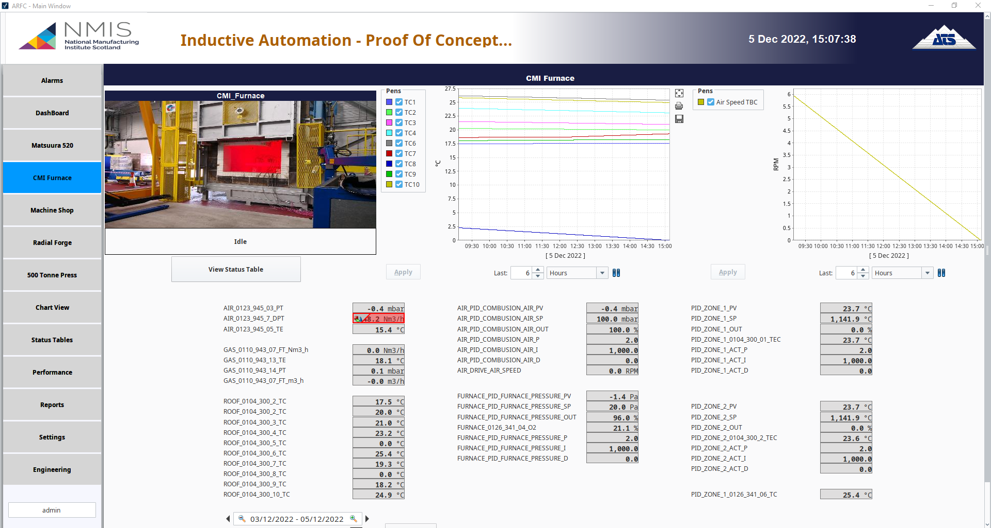
Optional: Ignition platform data
Additionally, if time allows, I would like to use data recorded via the Ignition platform which was setup this year as part of Resume project. The Ignition software also pulls the data from the furnace PLC/HMI and record it on its own SQL database.
Two datasets are available, the SQL CMI_DB database which has data recorded at fixed interval of 1 s and there is also the option to export manually the data (of selected tags) from the chart area (these tags are recorded on value change not fixed interval, this was done to reduce dataset size and optimize disk space).
It could be interesting to do some comparative performance analysis depending on the source of the dataset.
Figure – Screenshot from Inductive Automation dashboard for the CMI Furnace
Slide 8

Slide 9
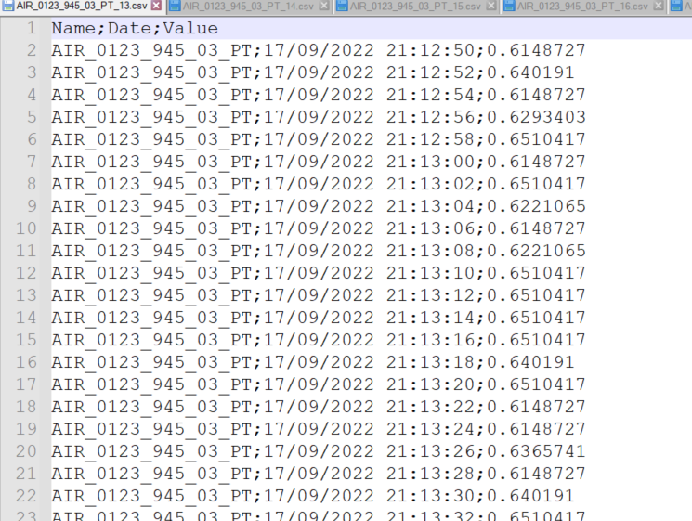
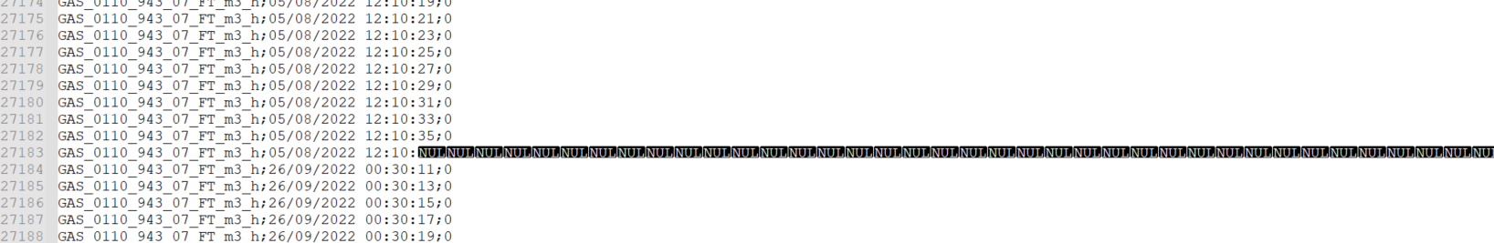
Data cleansing
As the data from the CSV files is neat and only consists in automatic generated time series (process value vs time stamp), data cleansing/processing should be minimal to create uniform/consistent datasets.
From past experience, we have seen that the last line can be corrupted so this will need to be monitored and fixed.
Also important to note that the separator is “;” not “,”.
Figure – Typical format of CSV file recorded on the NAS (separator is ;)
Figure – Bad data line discovered during data processing step in Python
File: GAS_0110_943_07_FT_m3_h_20, row 27183
Slide 9

Slide 10
Data carpentry
Import Libraries
Read CSV file containing the list of all the sensors/tags of interest
Read, process, append all the individual csv files into a set of data frames (one DF for each sensor) using "for" loops
Merge all the individuals DFs into a single dataframe
export the resulting merged DF to a pickled file for the following plotting and analysis operations
Reduce dataset size using a formatted index with regular time interval
Keep data within a specified date and time window
The figure on the right explains the strategy for the data processing to enable analysis & visualization.
In our project, data processing/carpentry is the main activity and consist of multiple appending, grouping and potentially filtering (decrease recording frequency) to reduce dataset when possible.
Few assumptions:
we have discarded lines with errors (< 0.00002% approx.)
We have use interpolation to calculate values for intermediate time stamp.
Figure – Strategy for the data processing.
Slide 10

Slide 11
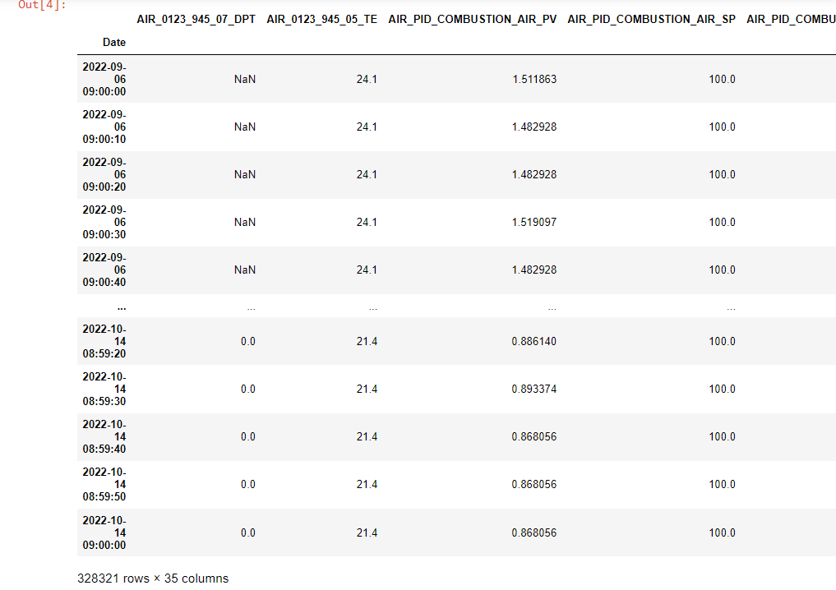
Data carpentry
All the data processing steps are well documented within the data processing Jupyter notebook.
The initial raw dataset consists of:
1645 csv files with a total size of 5.71 GB
The final clean dataset consists of:
Single Dataframe (Pickled pkl file) of 90.1 MB
~ 98.5% size reduction
Figure – Format of the final combined Pandas data frame.
Slide 11

Slide 12
Data analysis and visualisation
Import Libraries
Import the resulting merged DF from the pickled file following the data processing
Plot all sensors using subplots for a global visualisation
Identify faulty temperature sensors
Carry out some gas consumption calculation
Plot gas flow rate and oxygen concentration together with filtered data (smoother curves)
Plot various temperature sensors using interactive plot with zoom in option
Use Bokeh plotting tool to make another interactive plot
For this particular project, the data analysis will consist on various curve smoothing, create calculated tags with moving average, automatic detection of faulty sensors, etc…
We are also planning to carry out some calculation to estimate gas consumption for a selected period.
The main objective was to test out various plotting libraries which works well to visualise long time series.
Figure – Strategy for the data analysis and visualisation
Slide 12

Slide 13
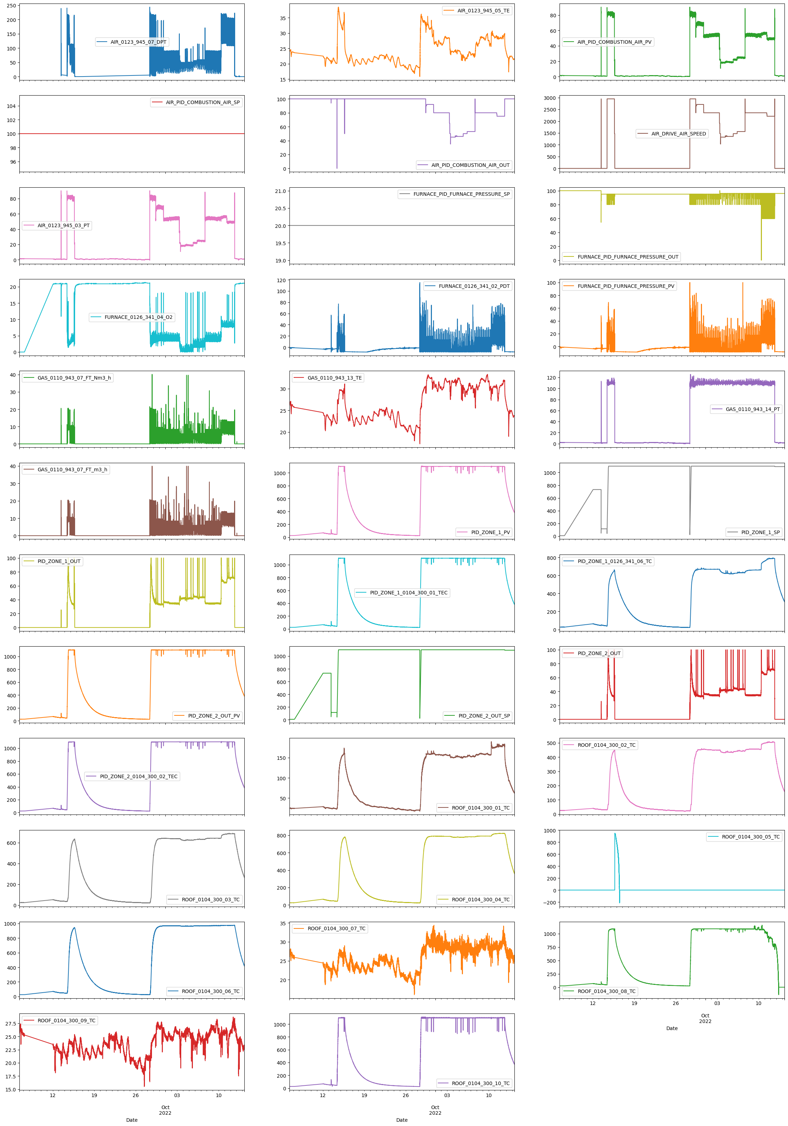
Data analysis and visualisation
The figure on the right shows all the subplots for all the sensors over the whole duration of the heat treatment.
Most of them represent temperature sensors, pressure sensors, flowrate sensors, equipment usage, etc…
It is a good initial step to look at the overall process data and identify any faults or strange behaviours.
Slide 13

Slide 14
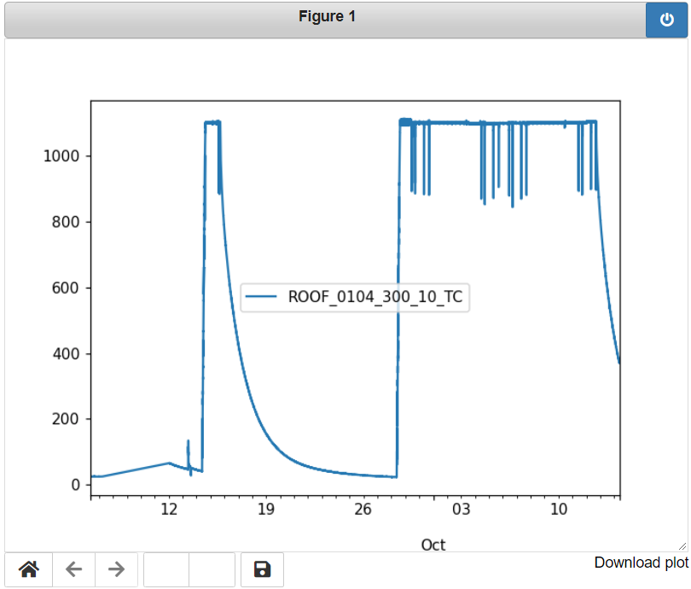
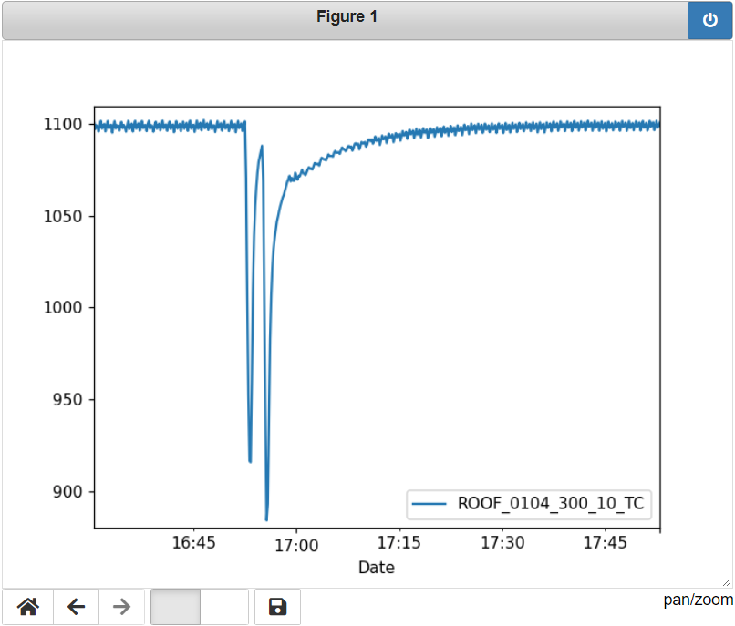
Data analysis and visualisation
The figure below on the left represents the temperature of Thermocouple 10 (centre of the grid) over the whole heat treatment duration and is plotted using the NBAGG tool which allows to zoom in.
On the right below, we are looking at the data within 1h30 frame (red rectangle) corresponding to the unloading and loading of a new part (i.e. two consecutive door openings).
Slide 14

Slide 15
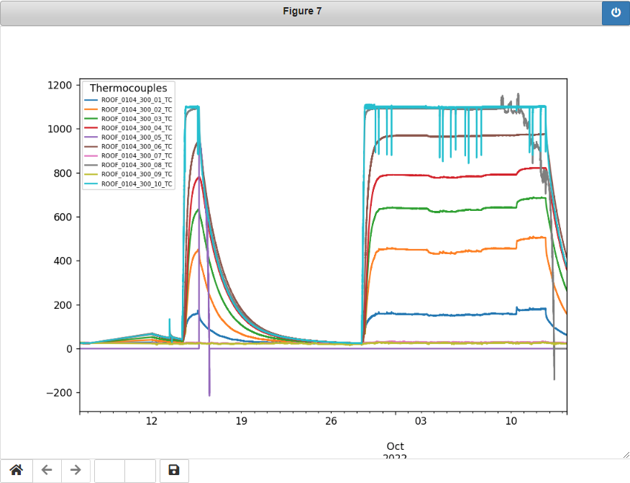
Data analysis and visualisation
This graph on the left shows the temperature profile of various thermocouples located in between the refractory wall layers.
This is useful to check if the furnace has reach a steady state as it usually take a couple of days to heat up refractory compared to few hours to heat up the useful zone of the furnace.
It is also a good way to check any thermocouple failure. This will be discussed later.
Door openings can also be easily spotted looking at Thermocouple 10 which is located in the middle of the grid.
Figure – Temperature profile from thermocouples located in each layer of the refractory wall (sandwich structure)
Slide 15

Slide 16
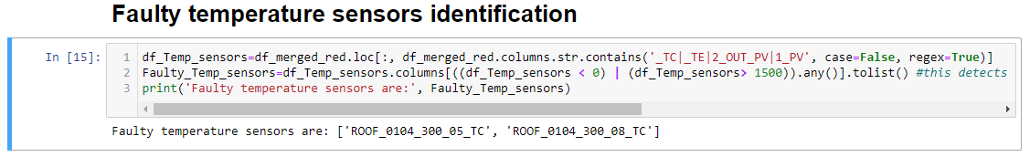
Data analysis and visualisation
The line of code above allows us to detect any faulty temperature sensors (looking at negative value and value above 1500 degC). This is quite common to have thermocouple failure in furnaces.
TC_05 and TC_08 became faulty during this test as seen in the earlier graph
In term of gas consumption analysis, I have used the Trapz method in Numpy to calculate area under curve of Figure 15 (top). I was surprised and reassured that the integration of the raw data and smooth/filtered data give almost exactly the same result: 2401.97 m³. This is detailed in the notebook.
A future work would be to tie in gas flowrate with calorific value on the day to get an estimate of the energy used rather than a volume of gas. The calorific values are usually provided every month by the energy supplier
Figure – Temperature profile from thermocouples located in each layer of the refractory wall (sandwich structure)
Slide 16

Slide 17
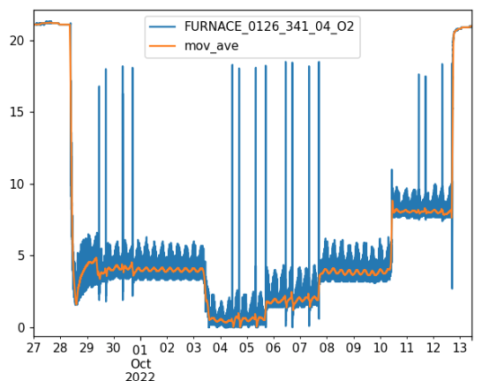
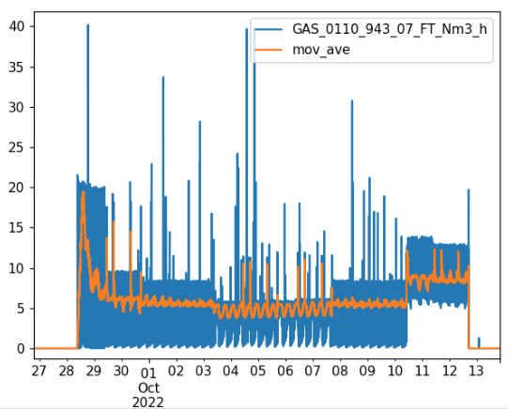
Data analysis and visualisation
The graphs on the right represent the oxygen concentration and corresponding gas consumption when we set the burners at different air to fuel ratio. The targeted oxygen concentrations were: 0.5, 2, 4 and 8%.
It is interesting to see that the higher the air excess, higher is the gas consumption which is logical. To help with the visualisation, I decided to use the uniform_filter1D function to smooth the data. The data change very rapidly due to way the furnace is running with burners on and off.
In future, I would like to try to do some machine learning to correlate the following sensor data:
• Oxygen concentration (FURNACE_0126_341_04_O2)
• Pressure (FURNACE_PID_FURNACE_PRESSURE_PV)
• Gas flow rate (GAS_0110_943_07_FT_Nm3_h)
• Air Flow rate (AIR_0123_945_07_DPT)
• Burner usage in % (PID_ZONE_1_OUT)
Figure – Oxygen concentration profile and corresponding gas consumption for the different burner settings.
Slide 17

Slide 18
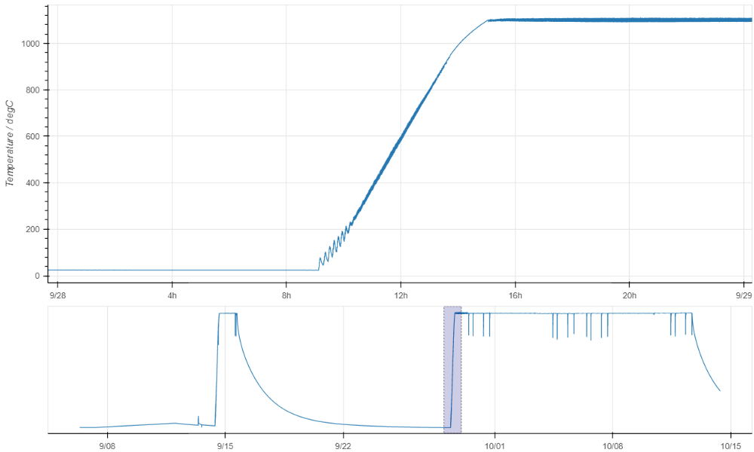
Data analysis and visualisation
The Figure on the left shows another example of interactive plotting using the BOKEH library. This is quite neat as it allow to show an highlighted area on the same graph.
This area can be changed live by the user.
Figure – Temperature graph using BOKEH library from TC10 over the whole duration of the heat treatment as well as zoom of interest during ramping up.
Slide 18

Slide 19
Conclusions and future work
This second assignment was destined to assess our knowledge of the processes and tools of data science that we learned during the course and to apply it to a real industrial problem.
In my case, I wanted to look at the CMI gas furnace and find an efficient way to process all the process data to enable basic analysis and visualization. I would say that the code I wrote is allowing me to do that. (Reducing data size from 5.7 GB to 90 MB for fast visualisation!). This was the most critical part of this work.
For this assignment, I did significant amount of research within the Python community and forums which has been very rewarding. I also managed to find and try out various interesting plotting tools.
Of course I see this as a work in progress and over the following months, I will keep optimizing the code and also spend more time on the analysis part, possibly looking at some machine learning.
In the future, the intention would be to deploy this methodology/strategy to other industrial furnaces with different data source such as Future Forge furnaces and AFRC member’s furnaces.
Slide 19

Slide 20
